Slide 1


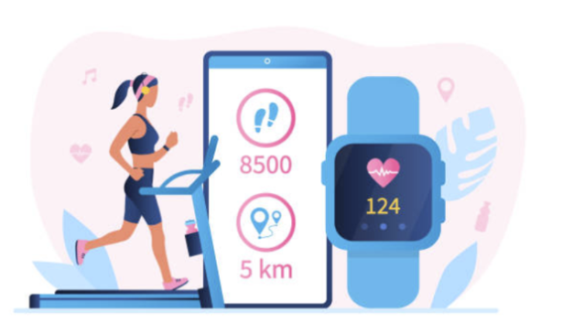

FITNESS TRACKER
Meta Scifor Technologies
Major Project
on
Submitted by,
Mrudula A P
Intern ID : MST03 – 0020
Guided by,
Urooj Khan

Slide 2
POINTS FOR DISCUSSION
Introduction
Problem Statement & Objective
Tech Stack used
Data Description
Model Development & Implementation
Conclusion
Future Scope

Slide 3
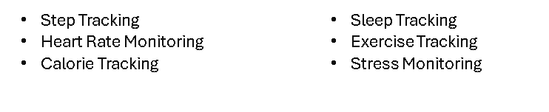
Introduction
In today's fast-paced world, maintaining a healthy lifestyle is becoming increasingly challenging.
Sedentary lifestyles and busy schedules often lead to neglect of physical fitness.
To address this issue, the development of a fitness tracker application leveraging advanced technology becomes imperative.
What is a Fitness Tracker?
A wearable device designed to monitor and track physical activity and health metrics. It promotes awareness of health habits and encourages a healthier lifestyle.
Types: Activity tracker, fitness band, smartwatch.
Key Functions:

Slide 4
Problem Statement & Objective
Problem: Current fitness tracking lacks personalized insights, hindering optimal results.
Challenge: Users struggle to interpret vast fitness data collected.
Solution gap: Market lacks a solution for intelligent analysis and tailored guidance.
Project goal: Develop a fitness tracker application (Step Count predictor) that utilizes machine learning algorithms to offer personalized recommendations and predictions based on user data collected from Fitbit devices.
Impact: Enhance user engagement and support in achieving fitness goals effectively.

Slide 5
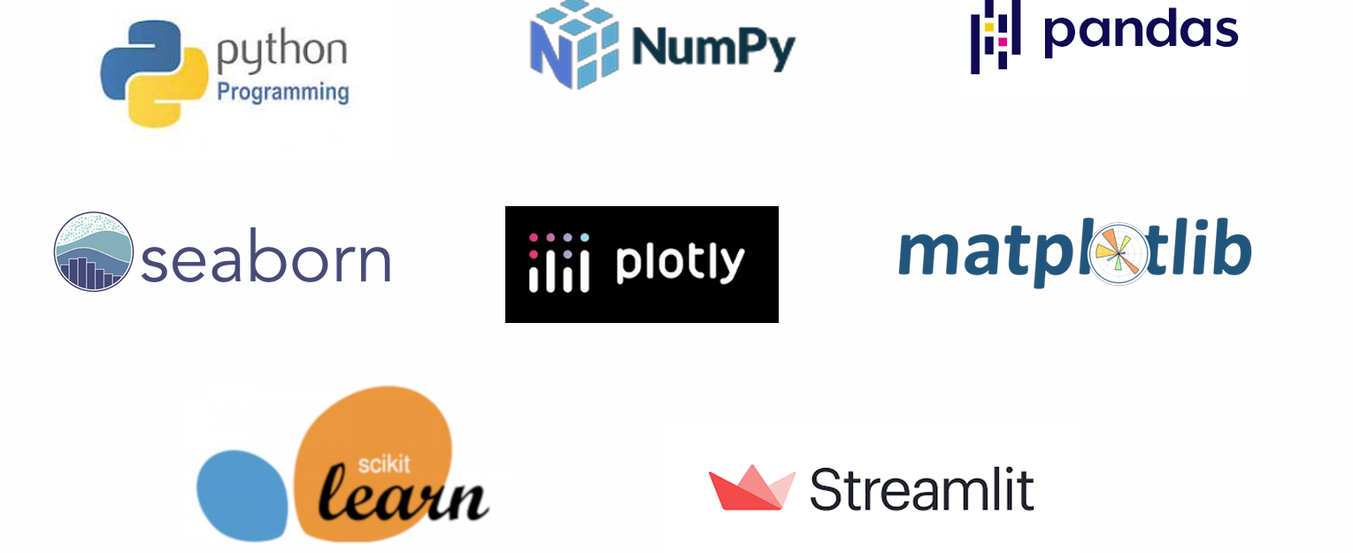
Tech Stack Used

Slide 6
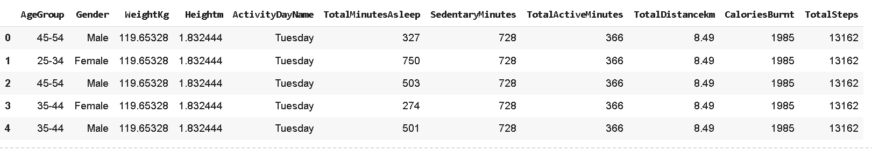
Data Description
About Dataset
The dataset used in this project was obtained from a distributed survey conducted on Amazon Mechanical Turk. Thirty eligible Fitbit users consented to submit personal tracker data spanning from 03.12.2016 to 05.12.2016. The dataset comprises minutelevel output for physical activity, heart rate, sleep monitoring, and other relevant metrics. Each user's data is organized into multiple files, such as dailyActivity, dailyCalories, hourlySteps, etc.

Slide 7
Model Development & Implementation
To implement the step count prediction model using Machine Learning, we'll follow these steps:
Data Preparation:
Gather data from Fitbit devices, including user inputs such as age group, gender, weight, height, sleep minutes, sedentary minutes, total active minutes, and total distance covered.
Cleanse and preprocess the data, handling missing values, outliers, and ensuring consistency.
Feature Engineering:
Extract relevant features from the collected data, such as BMI (Body Mass Index) from weight and height, and any other derived features that may enhance model performance.

Slide 8
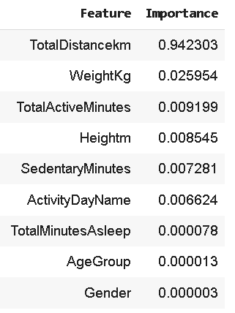
Feature importance for prediction of target variable (step counts)
3. Model Training:
Utilize the ML algorithms like Linear Regression, Random Forest and XGBoost to train a regression model on the prepared dataset.
Split the dataset into training and testing sets to evaluate model performance.

Slide 9
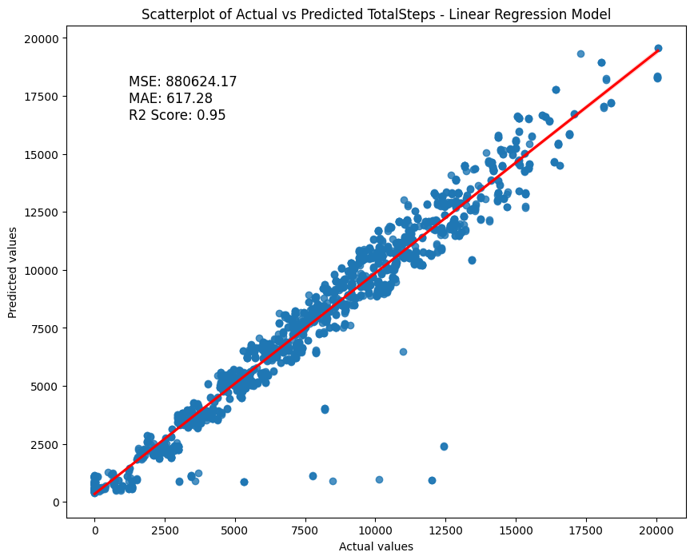
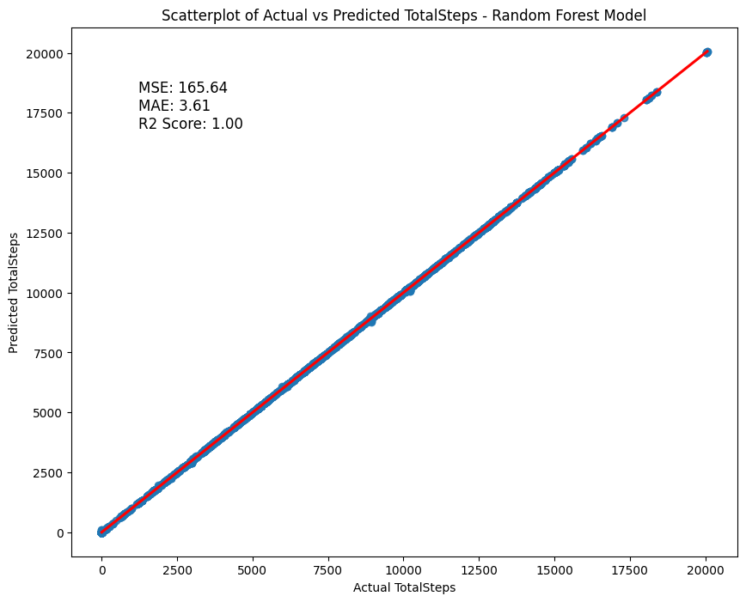
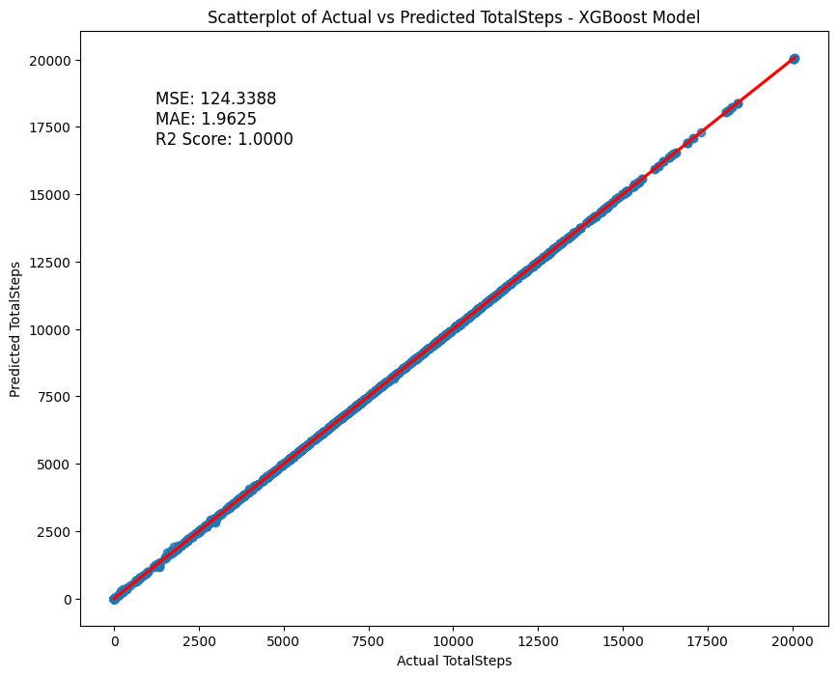
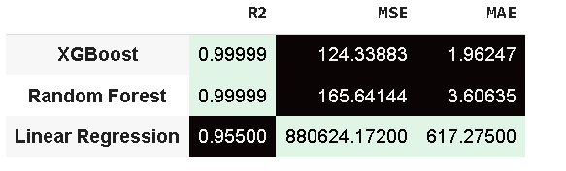
4. Model Evaluation:
Evaluate the trained models of Linear Regression, Random Forest and XGBoost using appropriate metrics such as Mean Absolute Error (MAE), Mean Squared Error (MSE), and R-squared (R2) score.
Validate the model's performance on the testing dataset to ensure its generalization ability.
XGBoost model is the best model as per R2 score, MSE and MAE.

Slide 10
5 . Integration with Streamlit:
Develop a user interface using Streamlit to collect user inputs such as age group, gender, weight, height, sleep minutes, sedentary minutes, total active minutes, and total distance covered.
Pass these inputs to the trained XGBoost model to predict the step count for the user.
6. Frontend Design:
Design an intuitive and user-friendly frontend interface using Streamlit, ensuring smooth navigation and a visually appealing layout.
Include features for input validation and error handling to enhance user experience.
7. Deployment:
Deploy the Streamlit application along with the trained XGBoost model on a server or cloud platform to make it accessible to users.
Ensure scalability and reliability of the deployed application to handle potential user traffic.
8. Testing and Iteration:
Conduct thorough testing of the integrated system to identify any bugs or issues.
Gather feedback from users to understand their experience and make necessary iterations to improve the application's functionality and usability.

Slide 11
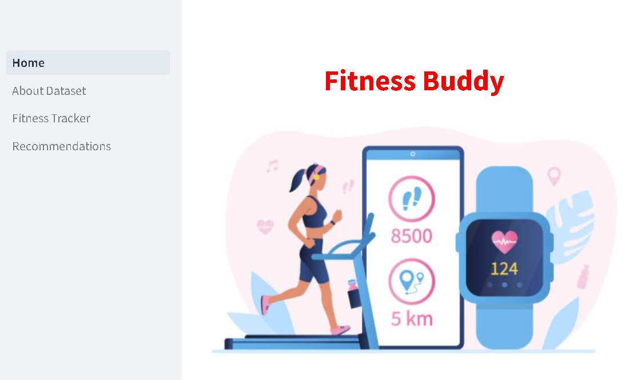
Streamlit Link : https://mrudulaapscifor-6wofqwzdrwd7ybsf2djvph.streamlit.app/

Slide 12
Conclusion
The fitness tracker app using machine learning algorithms offers a data-driven approach to personalized fitness tracking and exercise recommendations.
By analyzing user data collected from Fitbit devices and employing machine learning models, the app aims to enhance user experience and support users in achieving their fitness goals more effectively.
Through data collection, preprocessing, exploratory data analysis, feature engineering, model development, evaluation, and personalized exercise recommendations, the app provides valuable insights and guidance to individuals on their fitness journey.

Slide 13
Future Scope
While the current project aims to develop a robust fitness tracker application using machine learning techniques, there are several avenues for future enhancements and expansions:
Integration with More Wearable Devices: Expand the compatibility of the application to integrate with a wider range of wearable devices like smart clothing or biometric sensors beyond Fitbit.
Real-time Data Processing: Incorporate real-time data processing capabilities to provide users with instant feedback and insights. This could involve streaming data from wearable devices and continuously updating the prediction models to adapt to changing user behavior and preferences.
Enhanced Personalization: Further enhance the level of personalization in recommendations by incorporating additional user data, such as dietary preferences, fitness history, or health conditions. Utilize techniques like collaborative filtering or contextual bandits to tailor recommendations to individual users' unique contexts.

Slide 14

Thank You

